Slide 1
Lecture 1
Crop science
10th March 2022

Slide 2
Food supply system
The current world population of around seven billion is projected to reach nine billion in forty years or less. The UN projects agricultural output will need to increase by 70% just to maintain current dietary standards – which includes more than one billion malnourished people

Slide 3
As agriculture intensified, the human population grew as it transformed from a world of hunter-gatherers to one in which towns, cities, and countries competed with one another for food supplies and arable land.
Plants, once domesticated, have been continually improved by selecting those most productive for sowing.
The dramatic increase in world food production, which supplies feed for animal production and food for human consumption, has mainly come from improved crop cultivars, technological advances, and management practices.

Slide 4
The main objectives in feeding the world’s population include, first, the task of increasing world food production and improving dietary standards of the chronically undernourished and the expanding population
Second, have to deal with the overwhelming task of equitably distributing food to all regions of the world to offset the current consequences of population growth and increasing world hunger. without a strong balance between food production and distribution – in other words – social justice
Third, agriculture needs to accomplish these objectives with a minimum impact on the world’s biodiversity and our fragile environment
Fourth, the increased food production needs to be accomplished without significantly expanding existing levels of land under cultivation

Slide 5
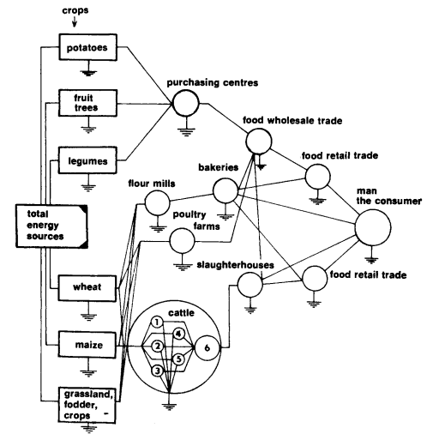
Food supply diagram

Slide 6
Crop science benefits
Crop science provides many benefits to our society and our environment
Produces food we eat and fiber for our clothing
Providing energy to power vehicles and heat our homes
Significant part of our national economy and provides many jobs directly for farmers and for others in the food and service industries
The food and fiber production system begins at the farm and proceeds through processors to the consumers

Slide 7
Benefits
Other related jobs are in various areas of production such as chemical fertilizer and pesticide production, crop consultants, seed and equipment dealers, food processing, and food wholesaling
The food and fiber sector is often called agribusiness and includes all firms engaged in producing, processing, transporting, marketing, and distributing products
Farmers or ranchers produce the raw materials that are ultimately transformed into fuel, food, and fibers
Farm input/service suppliers provide seed, fertilizers, pesticides, and equipment necessary to grow a crop

Slide 8
Food and fiber processors convert raw materials or commodities such as grains and livestock produced on the farm into products that can be sold to consumer
Marketers link the food processor to the consumer. This involves wholesale and retail sales

Slide 9
Other support system
Ministry of agriculture
Research centres
Universities

Slide 10
Application of science in crop production
Plant breeding
Fertilizers
Irrigation
Improved crop management

Slide 11
Crop classification
Cereal crops are grasses that produce edible grain
Wheat, rice, corn, millet and sorghum
Legumes grown for their edible
Soybeans, beans, peas, groundnuts, and cow peas
Forages are crops whose vegetative parts like stems, leaves, and sometimes attached seed or grain used for livestock feed
We use fiber from plants for clothing, rope, paper, and baskets
Sisal, cotton,
Root and tubers crops harvested for their underground storage organs that are rich in starch
potatoes, sweet potatoes, and cassava

Slide 12
Crop classification
Cover crops to prevent soil erosion due to water or wind during periods when the soil is not protected by growing plant cover
Rye grass and clover
Green manure crops are legumes or grasses that are incorporated into the soil while vegetative with the purpose of adding nutrients to the soil or enhancing soil quality
Sunhemp

Slide 13
Other classifications
Bioenergy crop is a general term that describes production of energy from biological systems
Corn, grain sorghum, and soybean are examples of biofuel crops
Sugarcane the crop from which sugar is obtained
Oil crops produce oils that contain fatty acids that vary in saturation include soybean, sunflowers, groundnuts and cotton
Medicinal crops grown for their unique compounds such as alkaloids and glycosides that have properties for pain relief, disease treatment, or other uses
Ginger, chilie, neem

